Slide 1
Salary Prediction
Prepared by :
Naga Surendera Babu.Aravapalli

Slide 2
Business Problem Understanding
Problem Statement: -
Delta Ltd. is committed to offer same salary among the employees with similar profiles. Currently, salary offers are influenced by subjective judgment during interviews, more inconsistency and potential bias. The Human Resources (HR) department needs a data-driven solution to determine appropriate salary ranges with consistent salary offers based on objective.
Constraints: - Limited availability or quality of historical data for certain roles or departments. Biases already present in historical data may affect model fairness and need mitigation. The model must comply with company policies and labor laws on equal pay and anti- discrimination. Regular monitoring and retraining of the model will be required to reflect market changes and ensure long-term fairness.
Scope: - The model will use historical recruitment data including: Academic qualifications, Years of experience, Publications and certifications, ratings of previous employment. The solution will be applied to all new candidates applying to Delta Ltd. The system will integrate with HR tools to suggest salary offers during the final stages of the hiring process.
Objectives: - Build a predictive model using historical employee data to determine fair salary offers automatically. Reduce human subjectivity in salary decisions during the hiring process. Ensure salary consistency and fairness across similar candidate profiles. Support HR in creating standardized salary bands based on quantifiable metrics like education, experience, technical skills, and performance in interviews.

Slide 3
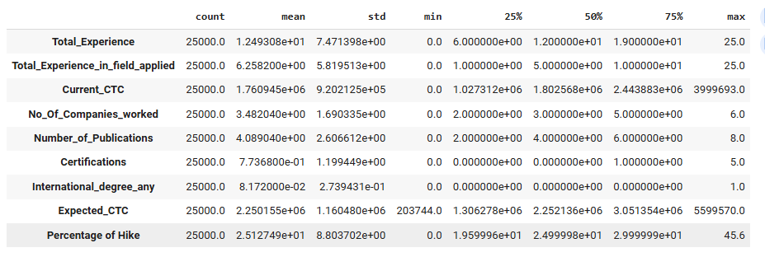
Data Overview: -
The data set has 29 columns and 25000 rows. It contains different types of attributes like int64, object and float64.
It has no duplicate entries in the data.
It has some missing values like no values under the experience column so it has replaced by “Fresher” and few of them updated as unknown according to the situation.
Statistical summary: -
The maximum expected ctc is 5599570 and minimum is 203744.
Entries count for respective variables 25000.
The average total experience is 1.24 years and std. is 7.47.
Inter quartiles displayed in percentages 25, 50, 75.

Slide 4
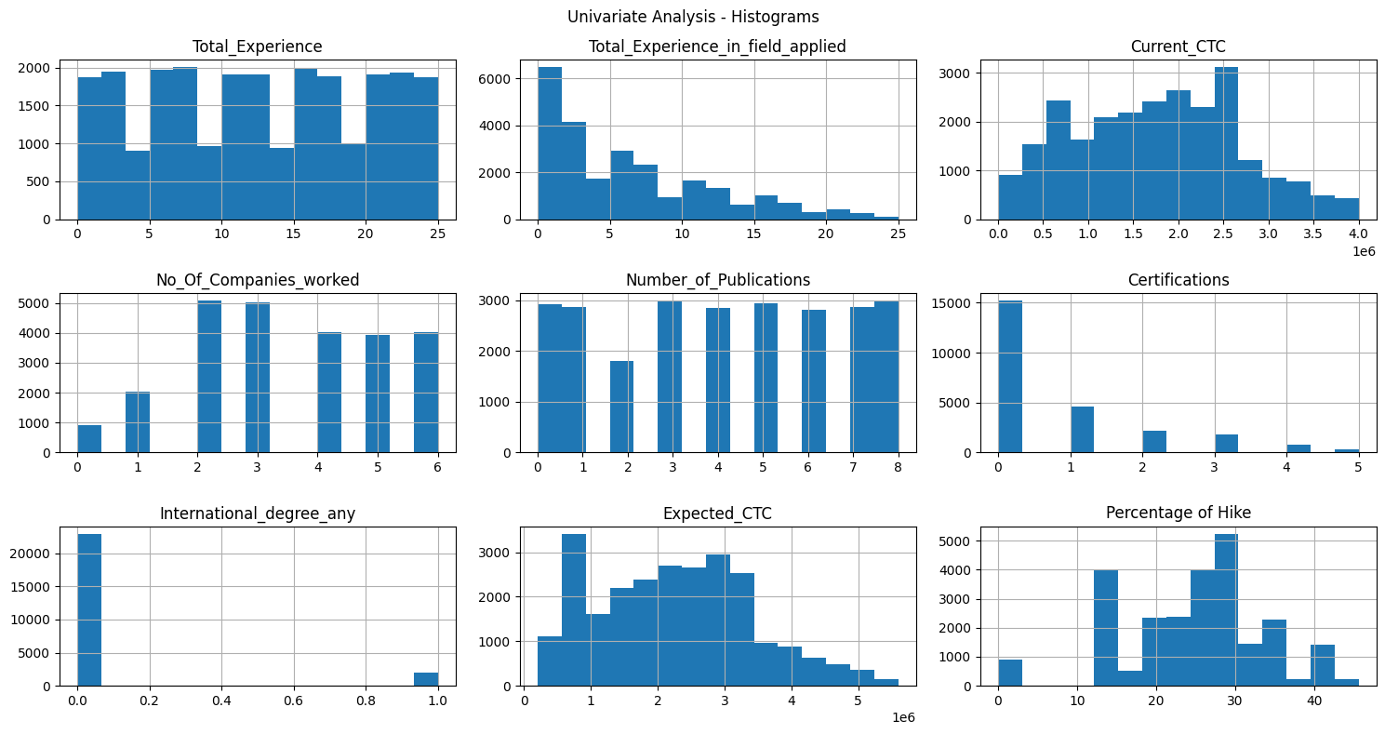
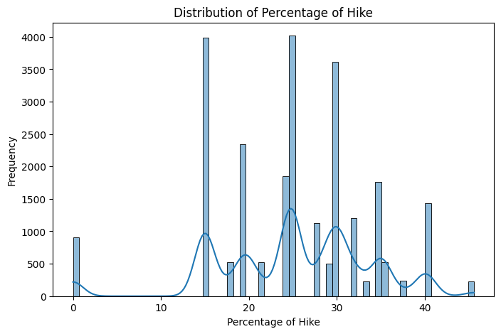
Exploratory Data Analysis: -
It includes Univariate and Bivariate analysis.
Univariate Analysis: -
It is an analysis of a single variable to view it's frequency.
Total Experience – balanced experience
Experience in Field Applied – More below 5 years
Current CTC - More in between 0.5 – 2.5 years
No. of Companies worked – More with 2 & 3 companies.
No. of Publications – Less publications are 2 papers.
Certifications – More candidates with 0 count.
Percentage of Hike – Most expected is 25-30%.
International degree any - Few Candidates with 1 degree and rest with 0 count.
Percentage of Hike distribution: -
The candidates expecting the hike percentages on their current_ctc are 15, 20, 25, 30, 35 & 40.
However, remaining are comparatively very less percentages which has low expectations.

Slide 5
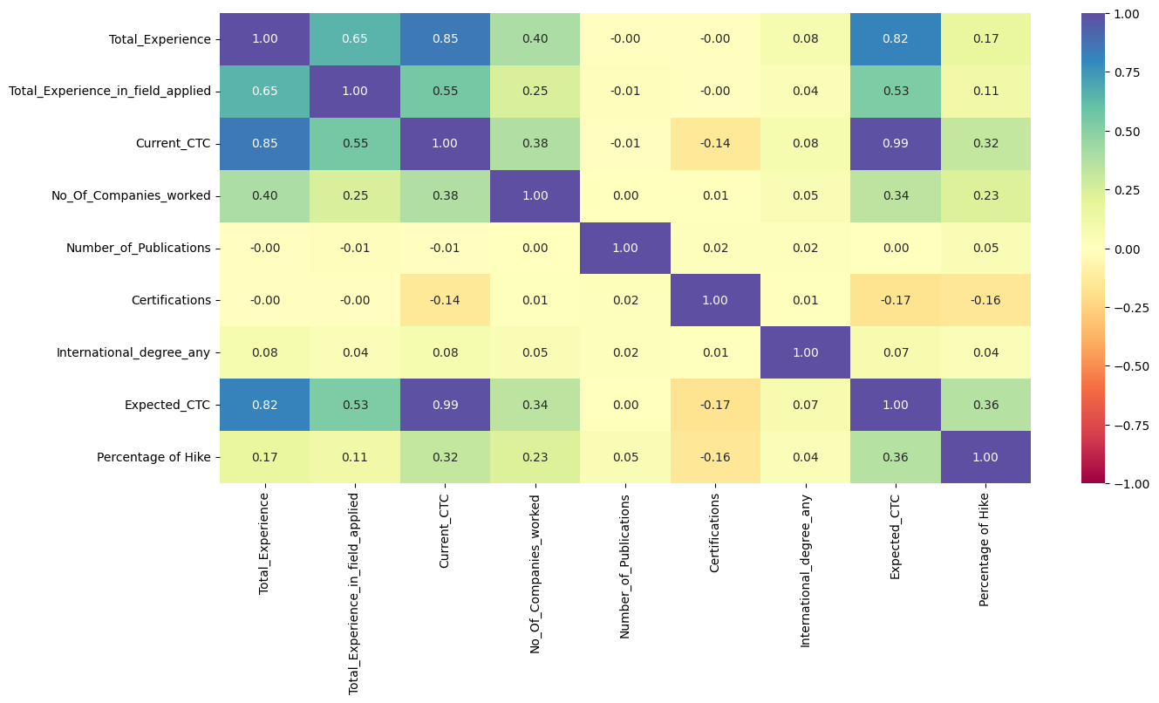
Bivariate Analysis: -
It is an analysis of two numerical variables to view their correlation.
Correlation Coefficient: -
It is called Pearson correlation coefficient.
Each compensation variable compare with other variables.
At 0.99 it measures a Strong positive correlation where as candidates expecting higher CTC are already receiving more Salaries.
At 0.85 & 0.82_Experienced candidates are looking for more salaries.
0.65_Strong relationship b/w Total experience vs field experience.
-0.17 shows a slight negative correlation and suggests
more certifications which do not necessarily lead to higher salary expectations.

Slide 6
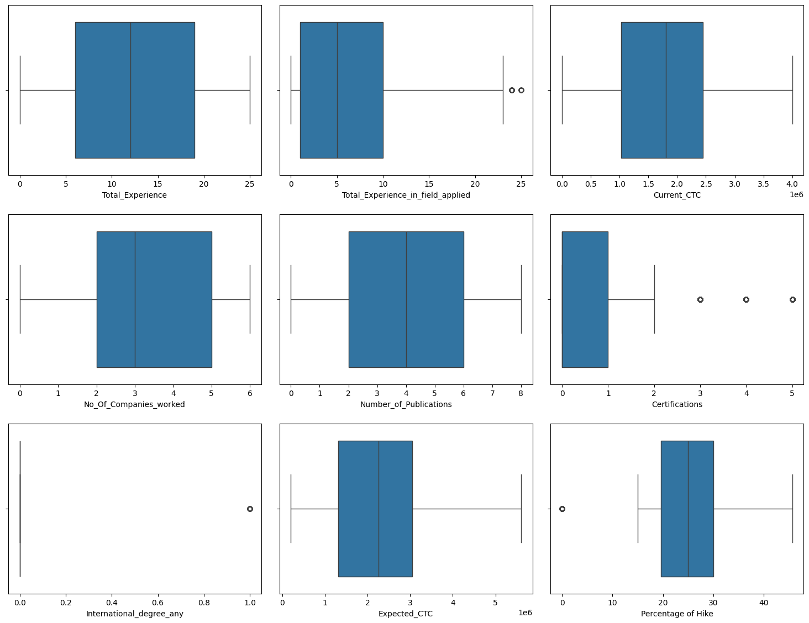
Outliers Check: -
It is an analysis of two numerical variables to view their correlation.
Total_Experience_in_field_applied: -
Two outliers (~25 years). Median is lower than total experience.
Certifications: - 3 Outliers at 3,4,5. Most of the candidates have certificates between (0-1).
International_degree_any: - Binary variable (0 or 1). Only one outlier means very few candidates are having an international degree.
Percentage of Hike: -
Median ~25% Right-Skewed and One outlier at 0.Other variables do not have any outliers.

Slide 7
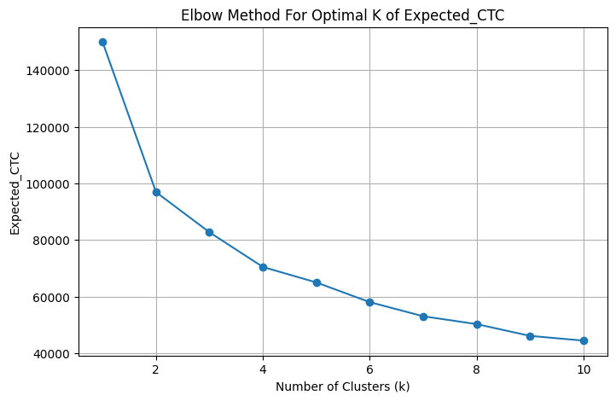
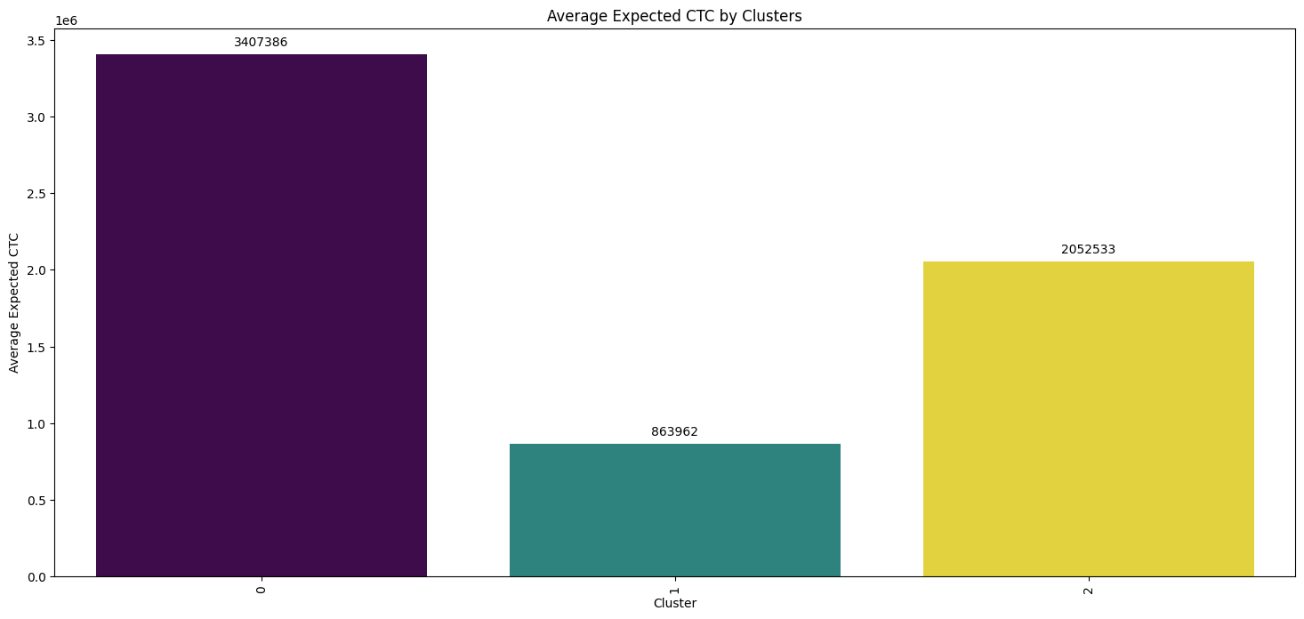
Clusters with Elbow Method: -
Elbow Method: -
It is called K-Means which has created clusters by applying Elbow method.
X-Axis: Number of Clusters/groups (K)
Y-Axis: Expected CTC
Optimal number of clusters (K) is likely 3 or 4 in elbow.
This point where you get the best balance between model complexity and performance.
Average Expected CTC by Clusters: -
Created 3 clusters by the average of expected salary which is reflecting in bar plot.
Cluster 0 group has highest salary expectations.
Cluster 1 candidates have the lower expectations of the salary.
Cluster 2 represents average hope for the expected ctc.
Hence, This clusterings can help HR or recruitment teams.

Slide 8
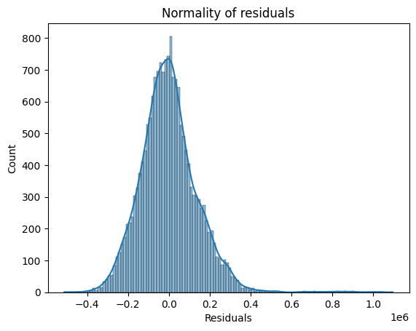


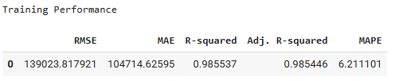

Modelling Approach Used: -
The Models used to develop a predictive model for more accuracy and generalization. Models were evaluated by using key performance metrics like R-square, Adjusted R-square, MSE, RMSE, MAE, MAPE. These approaches helps to prepare the strategies for salary predictions of the candidates according to their performance.
Linear Regression: -
Linear regression performance values for training and test set before Normalization.
After Normalization: - Since It is a normal distribution good for doing models even though
Some skewness and Bell-shaped curve. The testing accuracy is 98.6% and MAPE 6.21.
Models & Models Tuned Applied: -
Different regression Models applied for training set and test set for the accuracy. Models tuned also performed for evaluation of their performance of each model of both training set & test set. However, the consolidated tables added to compare/analyse their performances.

Slide 9
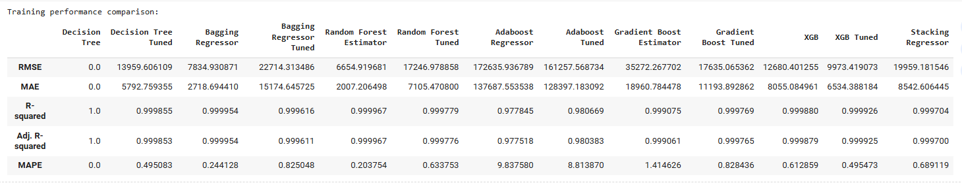
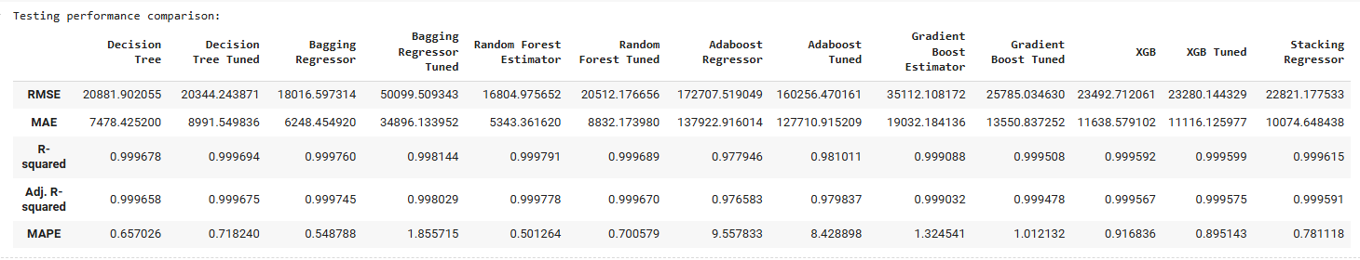
Modelling Approach Used Why: -
Tree-based models like Decision Tree, Random Forest and Bagging to capture the ability of non-linear relationships and interactions other than data preprocessing.
Boosting models are Gradient Boosting, AdaBoost, and XGBoost were tested for structured/tabular data prediction.
Stacking Regressor is used to combine multiple models to leverage their predictive performance.
The Models used to develop a predictive model for more accuracy and generalization. Models were evaluated by using key performance metrics

Slide 10
Insights from Analysis
xgboost is best model tuned performance with high accuracy(R-square - 99%), low error(MAPE - 0.895) and achieved RMSE ~137,582, MAE~104,421, R-square ~0.986 (98.6%) this model achieved 98.6% of variance in the target variable. Hence, Predictive metrics are strong.
The Tuned xgboost training and test metrics results are close so it has a good generalization and minimal overfitting. This is important in the real world to deploy the unseen data.
The tuned models of training and test set are performing well like Random Forest, Gradient Boost, and XGBoost. It represents robustness and enable these model’s suitable candidates for production use.
Only few candidates are with any international degree.
Only the candidates with 6-12 months have more expectations. Next the experienced candidates with 1 - 3.5 years are looking for more expected_ctc.
Total relevant field experience has two outliers and around 25 years generally they have high expectations.

Slide 11
Recommendations
xgboost is a balanced performance (low RMSE, high R², and low MAPE) so it should prefer to use this model for production.
These key performance indicators has to track regularly so it is better to setup alert mechanism if the model mechanism drops significantly.
It is good to retrain the new data either monthly or quarterly especially if there are seasonal patterns or any slowness in data.
There are some outliers which means some candidates are having over expectations especially with 6- 1 months experience so HR Team need to focus to prepare strategies accordingly.
There is a strong positive correlation between Current CTC & Expected CTC so current salary of the candidates should be low and should be in Cluster 1.
Consider the interaction of certifications/publications and expected CTC for modeling are useful prediction analysis of, hiring process, candidate expectations based on current salary.
Need use domain expertise depth to find the best candidates for production with low training which can help to control investment cost per head.

